Slide 1


Slide 2
Introduction
PCI DSS 4.0:Essential Compliance for Hospitality
  March 20, 2025
  10:00 AM - 11:30 AM EST
  OHLA President & CEO: Joe Savarise
  Meeting Chair: Ketan Pema
  PCI Compliance Expert: George Plytas
Notes:
Introductin from Joe Savarise
Ketan: Welcome everyone to today’s webinar on PCI DSS 4.0 compliance for the hospitality industry. With the March 31, 2025 deadline quickly approaching, hotels, resorts, and restaurants must ensure they are fully compliant with the latest Payment Card Industry Data Security Standard (PCI DSS 4.0).
Ketan: Why is PCI compliance critical?
Ketan: PCI compliance is essential for protecting guest payment information, avoiding substantial fines, and preventing reputational harm.
Ketan: What will we cover today?
Over the next 90 minutes, we will:
Break down key changes in PCI DSS 4.0.
Discuss compliance strategies specific to hospitality businesses.
Explore real-world challenges and solutions.
We'll conclude with a live Q&A session, so please submit your questions throughout the presentation.

Slide 3

What is PCI DSS
Global security standard for protecting payment card data
Formed by major card brands (Visa, MC, Amex, Discover, JCB)
First introduced in 2004, updated periodically
Notes:
Ketan: What is PCI DSS?
George: PCI DSS (Payment Card Industry Data Security Standard) is a global security framework designed to protect payment card data from breaches and fraud.
Ketan: Who created PCI DSS?
George: It was established in 2004 by the Payment Card Industry Security Standards Council (PCI SSC), comprising:
Visa.
MasterCard.
American Express.
Discover.
JCB.
Ketan: Why does PCI DSS keep evolving?
George: The standard undergoes regular updates to address emerging cyber threats. The latest version, PCI DSS 4.0, was released in March 2022 and includes significant changes in:
Authentication and password policies.
Encryption standards.
Security testing requirements.
Any business that processes, stores, or transmits cardholder data is required to comply.
https://east.pcisecuritystandards.org/

Slide 4
PCI DSS Compliance Oversight
PCI SSC: Sets the standards and guidelines
Card Brands & Acquirers: Handle enforcement, can levy fines, and restrict processing privileges
Merchants: Must maintain compliance to avoid fines, fees, or loss of credit card processing privileges.
Notes:
Ketan: What is

Slide 5
PCI DSS Merchant Levels
Transaction volumes dictate levels
Note: Transactions count, not $ amount
Level 1 - Over 6 million
  Any merchant that has suffered a data breach
  Intense annual audit by a QSA auditor
Level 2 - 1 million to 6 million
  Self Assessment Questionnaire (SAQ) validated by QSA
Level 3 - 20,000 to 1 million
E-commerce transactions annually require a SAQ
Level 4 - Fewer than 20,000 E-commerce transactions
Or, up to 1 million total transactions (across all channels) annually require a SAQ
Notes:
Ketan: What is

Slide 6
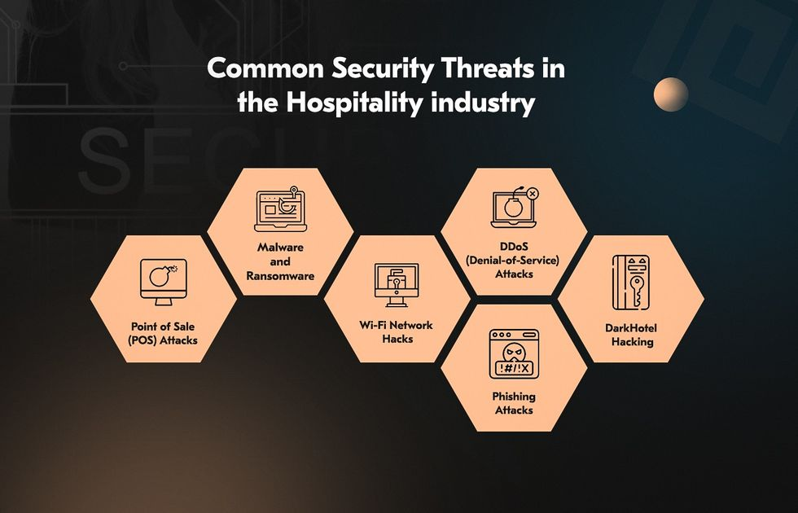
Why is PCI DSS 4.0 Important
For Hospitality?
It is mandatory
High-volume transactions, multiple payment touchpoints
A frequent target of
card data breaches
Failure to comply
may lead to fines &
reputational damage
Notes:
Ketan: Why does the hospitality industry need to care about PCI DSS 4.0?
George: The hospitality industry is high-risk for payment security because:
Hotels, resorts, and restaurants process millions of transactions daily
Payments happen at multiple touchpoints: front desk, restaurants, online booking, mobile apps, self-check-in kiosks
Third-party integrations (PMS, POS, OTAs) expand the attack surface
Ketan: How does non-compliance impact businesses?
George: Failing to comply can result in:
Fines from payment card networks
Legal liabilities
Loss of ability to process card payments
Reputation damage
https://images.prismic.io/secureframe-com/ZvyazrVsGrYSwQsg_PCIDSSHistory-Social.png?auto=format,compress

Slide 7

Key PCI DSS 4.0 Deadlines
March 31, 2024: PCI DSS 3.2.1 retired
Grace Period is almost over
March 31, 2025: Full compliance required
Notes:
Ketan: What are the key deadlines for PCI DSS 4.0?
George: Here are the critical dates:
March 31, 2024 → PCI DSS 3.2.1 was officially retired.
March 31, 2025 → Businesses must be fully compliant with PCI DSS 4.0.
Ketan: What does this mean for hospitality businesses?
George: With less than a year left, businesses must start implementing compliance changes now.
https://www.vecteezy.com/vector-art/550395-traffic-light - creator Goff Brian

Slide 8
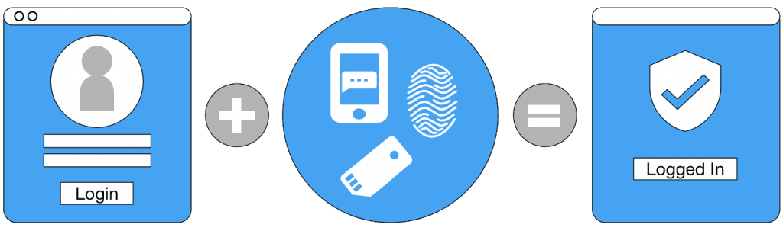
Major Changes in PCI DSS 4.0
MFA & stronger encryption required
Expanded password security requirements
Risk Assessment (TRAs)
Emphasis:
More frequent security testing
Logging and Monitoring
Notes:
Ketan: What are the significant changes in PCI DSS 4.0?
George: Key updates include:
Multi-Factor Authentication (MFA) Expansion:
Previously, MFA was required only for remote access.
Now, MFA is required for all access to Cardholder Data Environments (CDEs).
Enhanced Password Security:
Minimum password length increased from 7 to 12 characters.
Passwords must not be hard-coded in files or scripts.
Stronger Encryption Standards:
Enhanced encryption protocols for cardholder data in transit and at rest.
Applies to systems like Property Management Systems (PMS) and Point of Sale (POS) terminals.
Increased Security Testing:
More frequent vulnerability assessments and penetration testing.
Emphasis on continuous monitoring and risk assessments.
These updates necessitate IT system upgrades and comprehensive staff training within the hospitality sector.
https://msendpointmgr.com/2018/07/17/enabling-microsoft-mfa-for-users-in-the-organization-without-user-interaction/

Slide 9
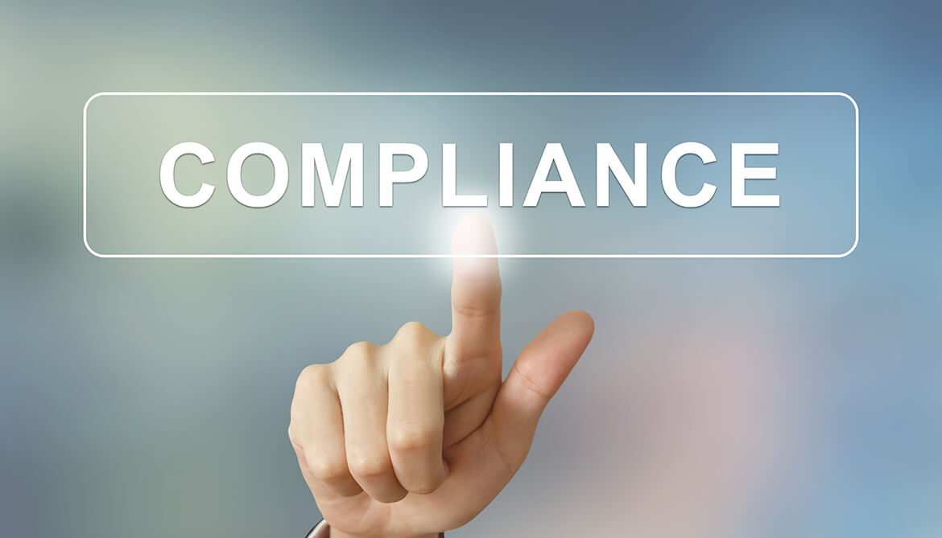
Other Compliance
Frameworks that apply
GDPR: Protecting EU guest data
State and federal privacy laws such as CCPA, CPRA, etc.
Ransomware and cyber threats
Notes:
Ketan: What other compliance concerns should hospitality businesses be aware of?
George: Beyond PCI DSS 4.0, hospitality businesses must address additional compliance and cybersecurity risks:
GDPR (General Data Protection Regulation)
Applies to hotels accepting EU guests, regardless of location.
Requires guest consent for data collection and strict data retention policies.
Heavy penalties for non-compliance—up to €20M or 4% of global revenue.
U.S. Privacy Laws (CCPA, CPRA, etc.)
California Consumer Privacy Act (CCPA) and California Privacy Rights Act (CPRA) require transparency in how guest data is collected, stored, and shared.
Other states, including Virginia (VCDPA) and Colorado (ColoPA), are introducing similar regulations.
Ransomware & Cyber Threats
Hospitality is a top target for ransomware due to sensitive guest data.
Cybercriminals now steal data before encrypting systems—threatening to release it if a ransom isn’t paid.
The best defense includes network segmentation, data backups, and endpoint detection & response (EDR) tools.
https://riskonnect.com/risk-management-information-systems/compliance-vs-risk-management/

Slide 10
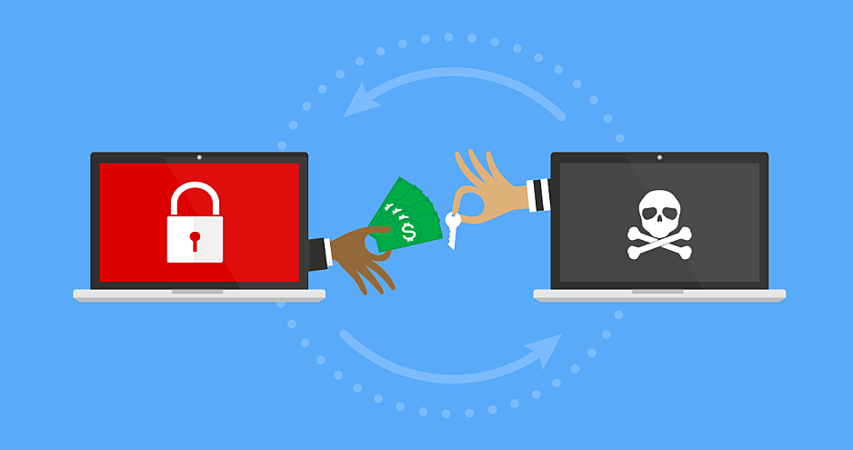
The Changing
Ransomware Landscape
Data theft now happens before encryption
Hackers use stolen data to pressure victims
Hospitality sector heavily targeted
Notes:
Ketan: How has ransomware evolved in recent years?
George: Ransomware attacks are no longer just about encrypting files. Today, hackers first steal customer data, then encrypt systems, and demand ransom.
Ketan: Why is this an even bigger threat now?
George:
Even if a business refuses to pay, attackers will sell or publish stolen guest and payment data.
Hotels, resorts, and restaurants are attractive because they store payment details, passport numbers, and PII.
Hackers use phishing, remote access vulnerabilities, and outdated systems to break in.
Ketan: How can businesses protect themselves?
George:
Implement frequent data backups—stored securely and offline.
Strengthen authentication controls (e.g., enforce MFA for remote access).
Monitor network activity in real time with Security Operations Centers (SOCs).

Slide 11
High-Profile Breaches in Hospitality
MGM Resorts International (2023)
10.6M guest records leaked
Name, contact information, gender, date of birth, and driver’s license number
Motel One (2023)
24M customer files accessed
Name, address, email, telephone, small amount of CC
Caesars Entertainment (2023)
Loyalty Program database stolen
Third-Party Vendor with privileged access
Name, address, driver’s license number and SSN
8-K Filing required with SEC
Notes:
Ketan: What are some major data breaches that have impacted hospitality?
George: Several high-profile hospitality data breaches have exposed millions of payment card records:
MGM Resorts (2020)
Over 10.6 million guest records were leaked online.
Hackers gained access via third-party cloud storage vulnerabilities.
Marriott (2018)
Attackers gained access to guest reservation databases, exposing 500 million records.
Data included credit card details, passport numbers, and PII.
Hyatt Hotels (2017)
Malware infected POS terminals across multiple locations, compromising payment card transactions.
Ketan: What lessons can we learn from these breaches?
George:
Segment critical systems to limit exposure.
Continuously monitor and audit access logs.
Ensure vendors handling guest data follow security best practices.

Slide 12
High-Profile Breaches in Hospitality
Omni Hotel (2024)
Took systems offline
Only cash and room charges accepted
Otelier (2024)
Ransomware
Guest reservations and email addresses
Hackers maintained access for 3 months until being discovered
Notes:
Ketan: What are some major data breaches that have impacted hospitality?
George: Several high-profile hospitality data breaches have exposed millions of payment card records:
MGM Resorts (2020)
Over 10.6 million guest records were leaked online.
Hackers gained access via third-party cloud storage vulnerabilities.
Marriott (2018)
Attackers gained access to guest reservation databases, exposing 500 million records.
Data included credit card details, passport numbers, and PII.
Hyatt Hotels (2017)
Malware infected POS terminals across multiple locations, compromising payment card transactions.
Ketan: What lessons can we learn from these breaches?
George:
Segment critical systems to limit exposure.
Continuously monitor and audit access logs.
Ensure vendors handling guest data follow security best practices.

Slide 13
Breach Costs
MGM Resorts:
$145 M ($100M in revenue and $45M in fines)
Motel One
An undisclosed amount of losses
Caesars Entertainment
$15 M paid to hackers for ransom
Significant financial impact
IBM: Average cost/breach in Hospitality – $3.36M
Notes:
Ketan: What are some major data breaches that have impacted hospitality?
George: Several high-profile hospitality data breaches have exposed millions of payment card records:
Marriott (2018)
Attackers gained access to guest reservation databases, exposing 500 million records.
Data included credit card details, passport numbers, and PII.
MGM Resorts (2020)
Over 10.6 million guest records were leaked online.
Hackers gained access via third-party cloud storage vulnerabilities.
Hyatt Hotels (2017)
Malware infected POS terminals across multiple locations, compromising payment card transactions.
Ketan: What lessons can we learn from these breaches?
George:
Segment critical systems to limit exposure.
Continuously monitor and audit access logs.
Ensure vendors handling guest data follow security best practices.

Slide 14
Fines Associated with PCI
Non-Compliance
Up to $100 per stolen card in fines
Liability for fraud losses from stolen cards
Legal fees and breach notification costs
Notes:
Ketan: What are the financial risks of PCI non-compliance?
George: A PCI compliance failure can result in severe financial consequences:
Fines from card brands (Visa, MC, Amex, Discover): Up to $100 per stolen card.
Liability for fraud losses: Businesses may be forced to reimburse the full amount of fraudulent transactions from stolen cards.
Breach notification costs: Legal fees, credit monitoring, and customer outreach can cost millions of dollars.
A major security incident can cripple a hospitality business financially.

Slide 15
Unique Challenges in Hospitality
High employee turnover makes training difficult
Legacy PMS & other systems may lack security updates
  Accounting systems
  Guest Wifi
  Office communication (O365 or Google for Business)
Third-party vendors increase the complexity
  Bars, restaurants and direct booking websites
Notes:
Ketan: What makes PCI DSS compliance particularly challenging for hospitality businesses?
George: Hospitality businesses face unique difficulties in securing cardholder data:
High Employee Turnover
Seasonal staff make it hard to enforce consistent security training.
Legacy Systems
Older Property Management Systems (PMS) and Point-of-Sale (POS) terminals may not support modern encryption and authentication requirements.
Third-Party Vendors
OTAs, payment processors, and booking engines introduce security risks if not properly vetted.
Tackling these challenges requires continuous monitoring, vendor assessments, and cybersecurity awareness programs.

Slide 16
Best Practices for PCI DSS 4.0
Use P2PE & tokenization to reduce risk
Implement MFA & strong authentication
Encrypt all cardholder data in transit and at rest
Notes:
Ketan: What are the best practices for PCI DSS 4.0 compliance?
George: Hospitality businesses should prioritize these strategies:
Reduce Payment Data Risk
Use Point-to-Point Encryption (P2PE) and tokenization to prevent storing raw cardholder data.
Enhance Authentication
Implement Multi-Factor Authentication (MFA) for all system access.
Secure Data Transmission & Storage
Ensure all payment card data is encrypted both in transit and at rest.

Slide 17
Implementation Strategy
Minimize Scope if possible
Conduct a PCI DSS 4.0 gap assessment
Prioritize authentication & encryption updates
Train staff & improve security awareness
Notes:
Ketan: How should hospitality businesses implement PCI DSS 4.0 compliance?
George: A structured implementation plan is crucial. Steps include:
Conduct a PCI DSS 4.0 Gap Assessment
Identify high-risk areas and develop a remediation plan.
Prioritize Security Controls
Implement MFA, enhance encryption, and reduce payment data exposure.
Employee Training & Awareness
Train front desk staff, restaurant employees, and IT teams on secure payment handling.

Slide 18
Breach Incident Response
Have a plan in place
  Support from ownership top-down
  Get support from an expert (finding gaps)
Have your staff rehearse the plan
  Identify
  Contain
  Eradicate
  Fortify
  Lessons Learned

Slide 19
Responding to a Breach
Ensure Cyber insurance will provide you with:
  A Cyber Attorney
  Incident Response support
  Breach Coach
  Negotiators
  PR Firm for reputation management
  Compliance guidance
    Each state and some countries have unique
    requirements for privacy reporting

Slide 20
Conclusion & Next Steps
Start PCI DSS 4.0 compliance efforts now
Protect guest payment data & avoid fines
Reach out for expert guidance

Slide 21
Next Steps & Future Webinar
Smart Surveillance Predicative AI on Video
Next Webinar:
March 27, 2025

Slide 22

OHLA Innovation & Technology Committee Meeting
Thank you
Free One-Hour Assessment
kpema@defenovate.com
513-255-5847

